Slide 1

Team 29
CS 4824 Project Proposal
Eshan Kaul

Slide 2
Motivation
India is the third largest global consumer of energy in the world
Our motivation for this project is to encourage the use of renewable energy sources, such as solar energy, in order to increase sustainability and conserve foreign economic expenditures
Solar power reduces greenhouse gas emissions and subsequently, the country’s dependence on fossil fuels
We would ultimately like to reduce India’s energy consumption by predicting the exact amount of energy needed to be produced by Indian solar plants.

Slide 3
Data Set
The data was retrieved from Kaggle
Gathered at two solar power plants in India over a 34 day period.
Data is split into two files a plant generation data file and a plant weather sensor data file.
Plant generation file is gathered at the inverter level: each inverter has multiple lines of solar panels attached to it (dim: 68778 rows × 7 columns).
The sensor data is gathered at a plant level: single array of sensors optimally placed at the plant (dim: 3182 rows × 6 columns).

Slide 4
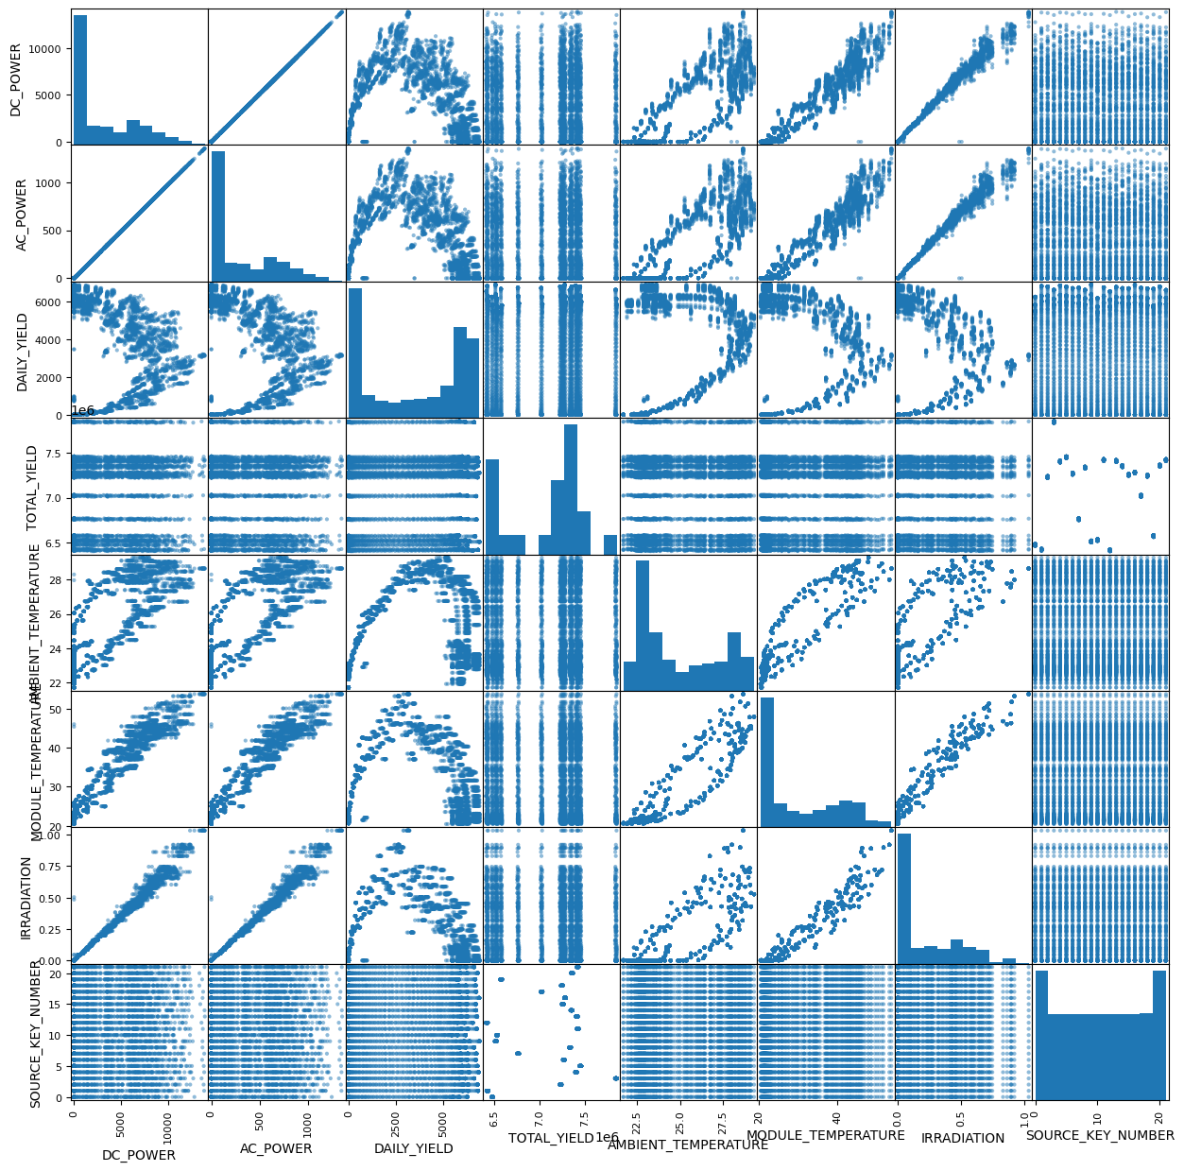
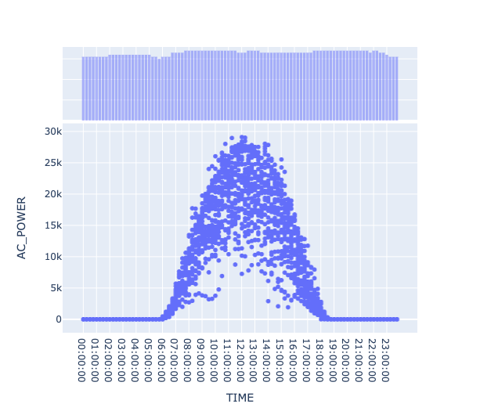
EDA

Slide 5
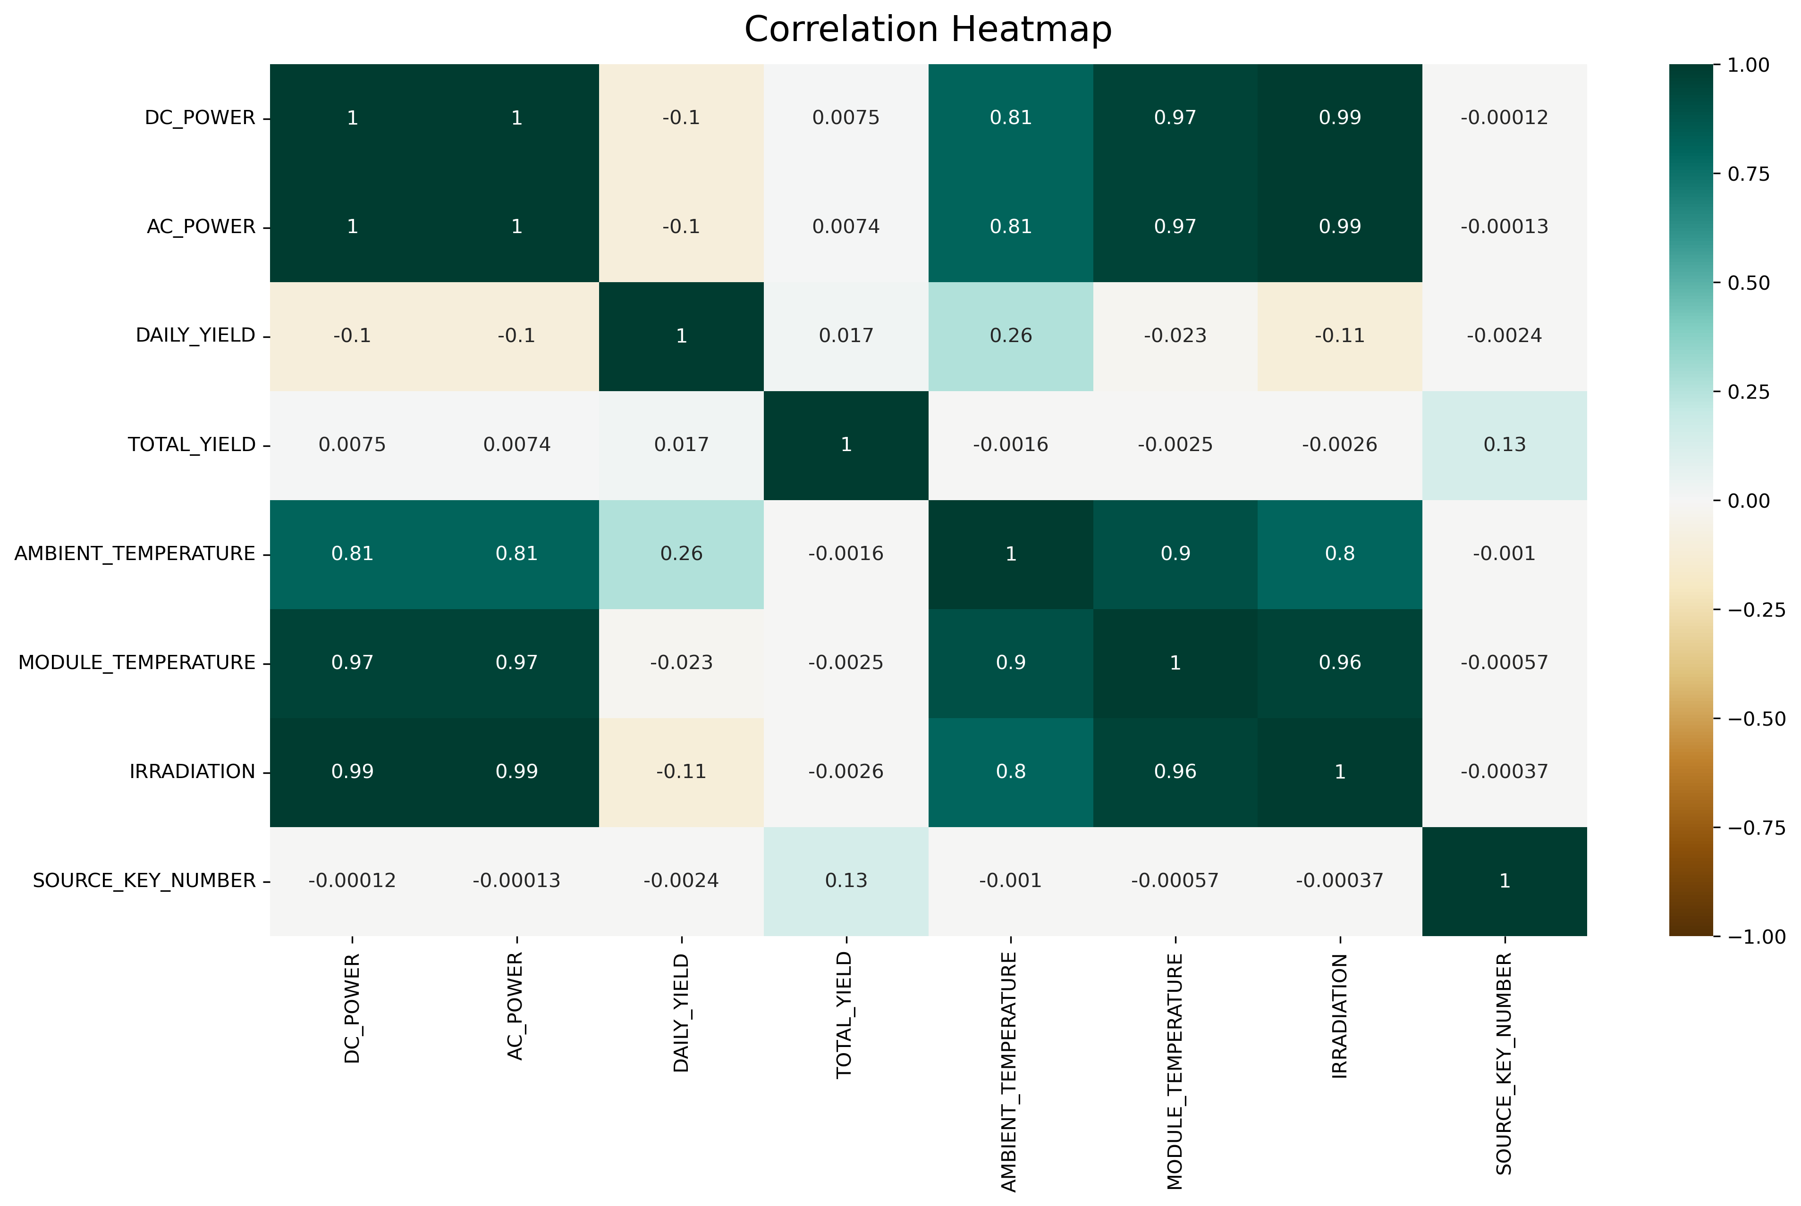
EDA

Slide 6
Model 1: Decision Tree Regressor
Introduction:
A Decision Tree Regressor is a tree-based machine learning algorithm used for regression tasks.
It recursively splits the input features into two subsets based on a chosen feature and threshold value, minimizing the mean squared error (MSE) in each subset.
Initialize the Decision Tree Regressor:
Set the maximum depth of the tree (max_depth) and the minimum number of samples required to split a node (min_samples_split).
Initialize the tree's attributes: feature_idx, threshold, left, right, and value.
Fit the Decision Tree Regressor:
Check if the stopping criteria are met (number of samples >= min_samples_split and max_depth > 0). If not, proceed to step 4. Otherwise, go to step 5.
Find the best feature and threshold to split the data:
Iterate over all the features and unique threshold values.
For each feature and threshold, split the target values into two groups: those less than the threshold and those greater than or equal to the threshold.
Compute the loss as the sum of the mean squared errors of the two groups.
Choose the feature and threshold with the lowest loss.
Split the input data into two subsets based on the chosen feature and threshold.

Slide 7
Model 1: Decision Tree Regressor
Recursively build left and right subtrees:
Create a left subtree by fitting a Decision Tree Regressor on the left subset of the data, with max_depth decremented by 1.
Create a right subtree by fitting a Decision Tree Regressor on the right subset of the data, with max_depth decremented by 1.
Compute the leaf value:
If the stopping criteria are met, calculate the leaf value as the mean of the target values in the current node.
Predict with the Decision Tree Regressor:
If the current node is not a leaf, check the feature value for each input sample against the threshold:
If the feature value is less than the threshold, pass the sample to the left subtree.
If the feature value is greater than or equal to the threshold, pass the sample to the right subtree.
If the current node is a leaf, assign its value to all input samples.
Combine the predictions from the left and right subtrees to obtain the final predictions.
Compute the Mean Squared Error (MSE) for a given target array:
Calculate the difference between the target values and their mean, square the result, and compute the mean of the squared differences.
By following these steps, the Decision Tree Regressor will construct a tree that can be used for predicting continuous target values based on the input features.

Slide 8
Model 1: Results
X = 'DAILY_YIELD', 'TOTAL_YIELD', 'AMBIENT_TEMPERATURE', 'IRRADIATION’
Y = ‘AC_POWER’
R^2 score: 0.9453311692516064
MSE: 8780.511186210757
RMSE: 93.70438189439572

Slide 9
Model 2: Gradient Boosting
The GradientBoostingRegressor is an ensemble learning method that combines multiple weak Decision Tree Regressors to form a strong learner. It sequentially trains weak learners, where each new tree is fit to the residual errors of the previous ensemble. Gradient Boosting Regressor algorithm steps:
Initialize the model with a constant value (bias), which is the mean of the target values (y).
Set the number of estimators (n_estimators) to be used in the ensemble, the learning rate, the maximum depth of the trees (max_depth), and the minimum number of samples required to split a node (min_samples_split).
Train the model using the following steps for each estimator :
Calculate the residuals, which are the differences between the target values (y) and the predicted values (y_pred) from the current ensemble.
Fit a new Decision Tree Regressor to the residuals using the specified max_depth and min_samples_split parameters
Add the new Decision Tree Regressor to the list of estimators.
Update the predicted values (y_pred) by adding the learning rate multiplied by the predictions of the new Decision Tree Regressor.
After training all the estimators, the final ensemble model is ready for prediction.
To make predictions with the Gradient Boosting Regressor, start with the bias and then add the product of the learning rate and the prediction of each Decision Tree Regressor in the ensemble.

Slide 10
Model 2: Results
X = 'DAILY_YIELD', 'TOTAL_YIELD', 'AMBIENT_TEMPERATURE', 'IRRADIATION’
Y = ‘AC_POWER’
R^2 score: 0.8136697715417036
MSE: 29927.0101977689
RMSE: 172.99424903091113

Slide 11
Model 3: Kernel Partial Least Squares
Partial Least Squares (PLS) is a multivariate regression method
The goal of PLS is to find a low-dimensional representation of the input data that captures the maximum covariance between the input and output variables
PLS works by iteratively extracting pairs of latent variables or "components" that capture the maximum covariance between the input and output variables
These components are then used to build a linear regression model

Slide 12
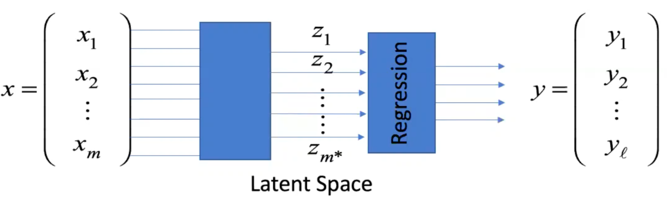
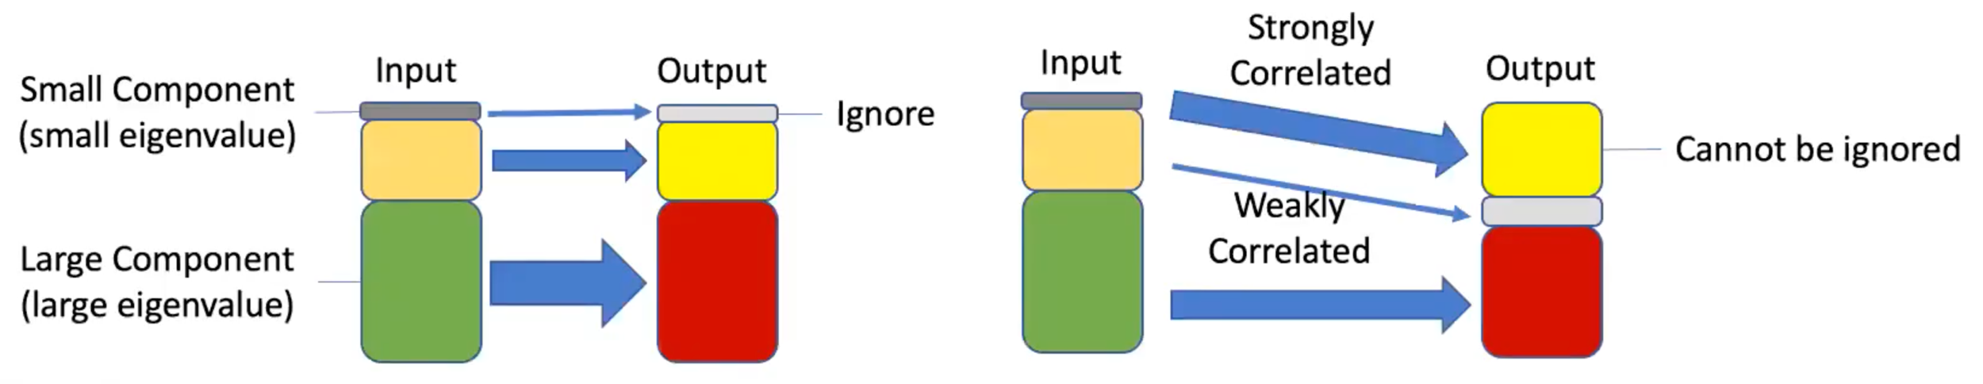
Latent Modeling

Slide 13
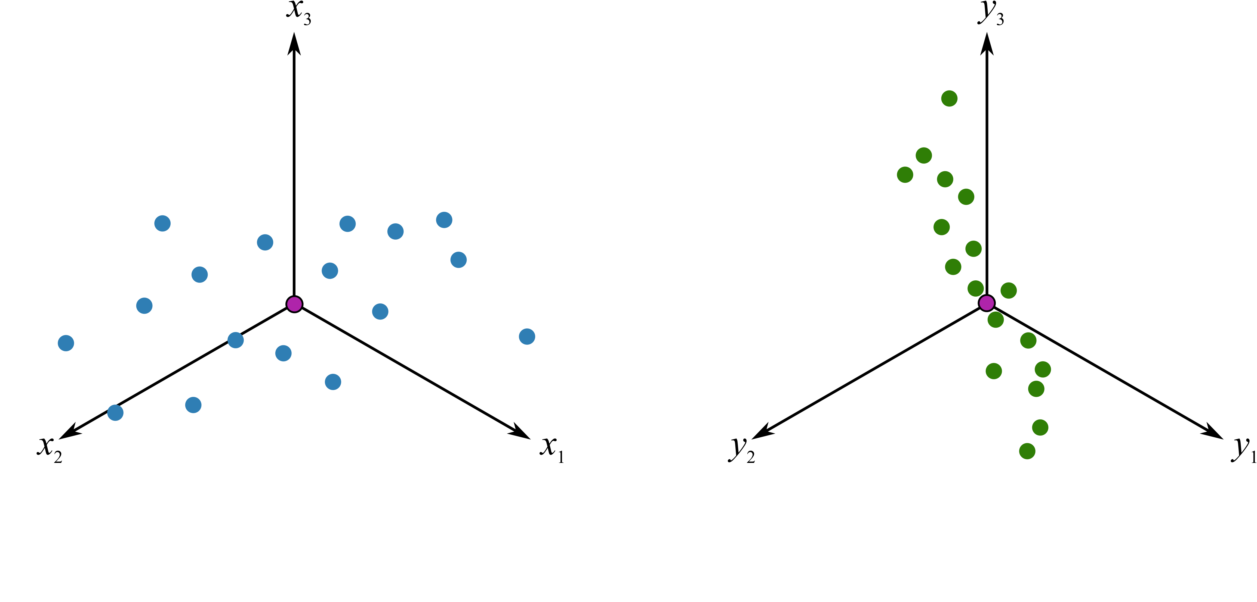
Latent Modeling

Slide 14
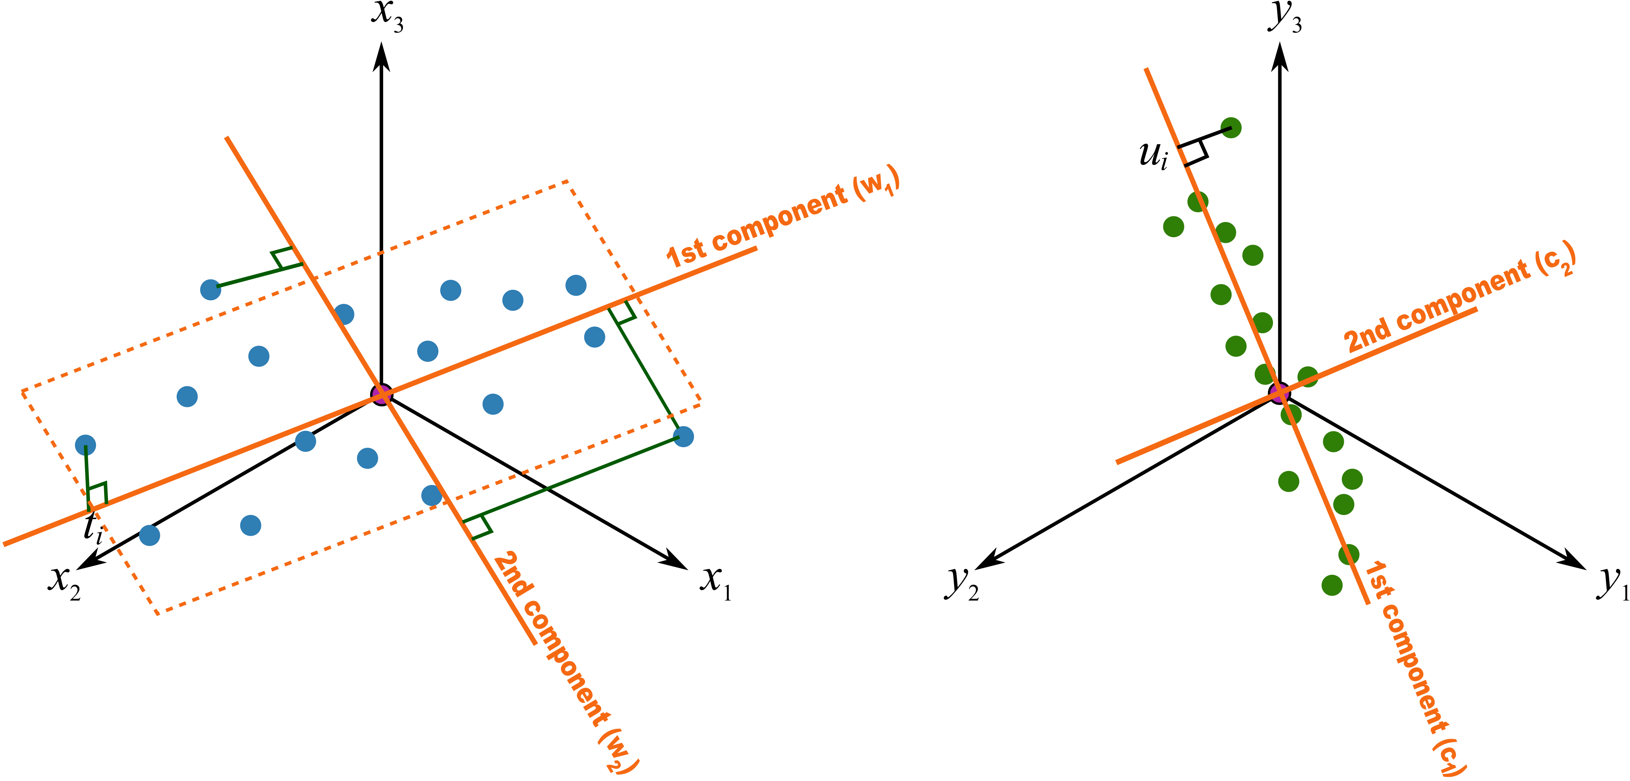
Latent Modeling

Slide 15
Model 3: Kernel Partial Least Squares
Preprocessing: If center = TRUE, the mean of each column of X and Y is subtracted from the corresponding column. Otherwise, the data are used as is.
Initialize: Set i = 1, initialize the residual matrices E and F as X and Y, respectively.
Calculate the kernel matrices: Calculate the kernel matrix KX as the inner product between the preprocessed X data and itself, and the kernel matrix KY as the inner product between the preprocessed Y data and itself.
Calculate the scores: Calculate the scores T and U as the normalized eigenvectors of the matrices KX and KY, respectively. Normalize by the eigenvalues.
Calculate the loadings: Calculate the loadings P and Q as the normalized inner product between X and T, and Y and U, respectively.

Slide 16
Model 3: Kernel Partial Least Squares
6. Calculate the loading weights: Calculate the loading weights W and C as the normalized eigenvectors of the matrix X'PWY, where X' is the transpose of X. Normalize by the eigenvalues.
7. Calculate the coefficient matrix: Calculate the coefficient matrix B as the product of W and C'.
8. Update residual matrices: Calculate the new residual matrices E and F as E_new = E - TP' and F_new = F - UQ'.
9. Check convergence: Check the convergence criterion. If i < ncomp and the residual matrices E and F have not converged, go to step 3 with i = i + 1. Otherwise, stop.

Slide 17
Model 3: Results
X = ‘MODULE_TEMPERATURE’, 'DAILY_YIELD', 'TOTAL_YIELD', 'AMBIENT_TEMPERATURE', ‘MODULE_TEMPERATURE’, 'IRRADIATION’
Y = ‘AC_POWER’
R-squared: 0.8920075470470994
RMSE: 0.3286220518359969

Slide 18
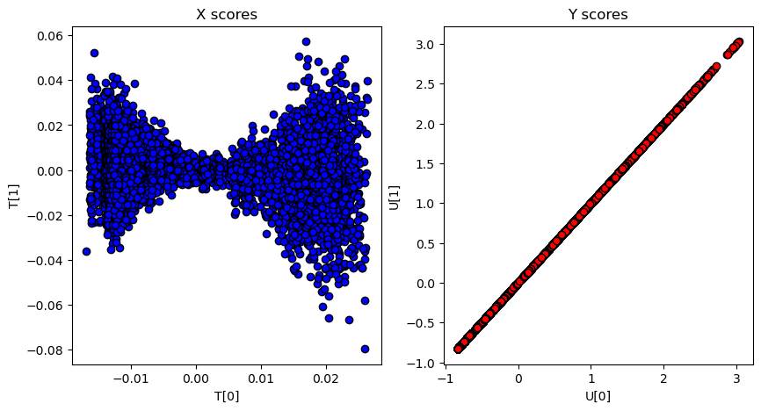
Model 3: Results

Slide 19
Conclusion
Explored 3 regression models: Decision Tree Regressor, Gradient Boosting, & Kernel Partial Least Squares
KPLS appeared to have the best performance
Future Considerations: Explore methods that are specified to handle a sparse data problem such as Orthogonal Matching Pursuit
Data limitations: Model may not accurately predict power plant output given seasonal/climate changes.
Ethical concerns: The model could potentially be misused by a solar plant could potentially overcharge after predicting the optimal price point

Slide 20

Thank you!

